Slide 1
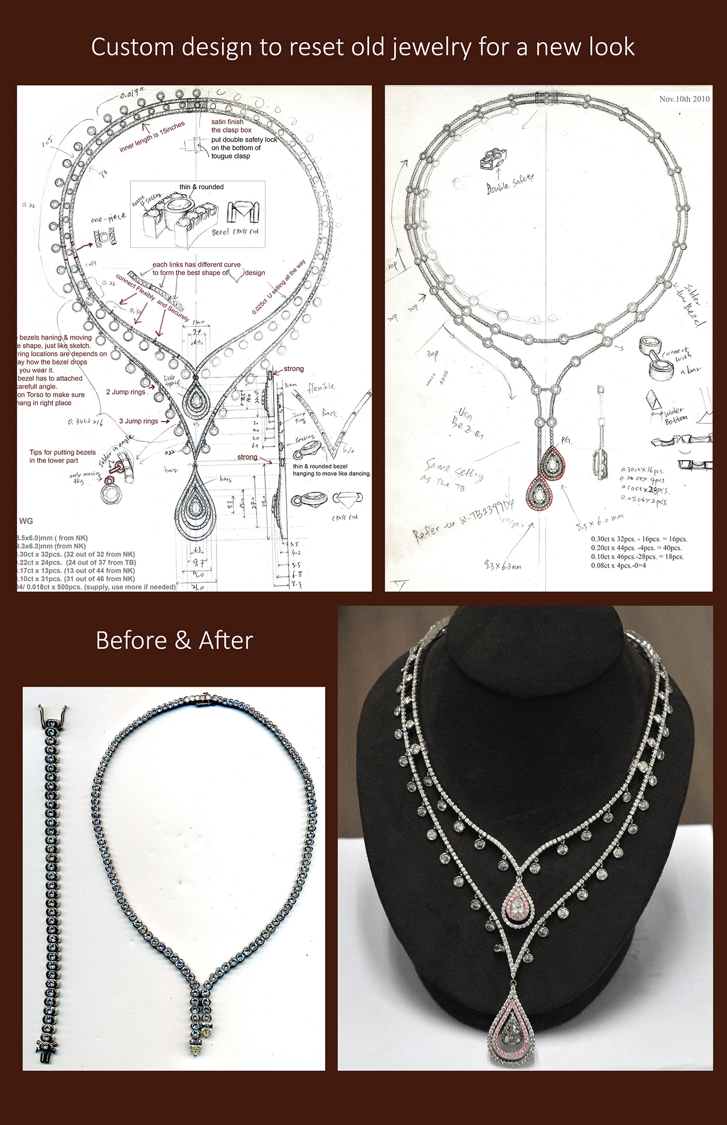
JEWELRY DESIGN PATTERN GENERATION
Converting Sketched Images to Realistic Jewelry Designs Using MERN and Deep Learning.
Instant Jewellery Visualization

Slide 2
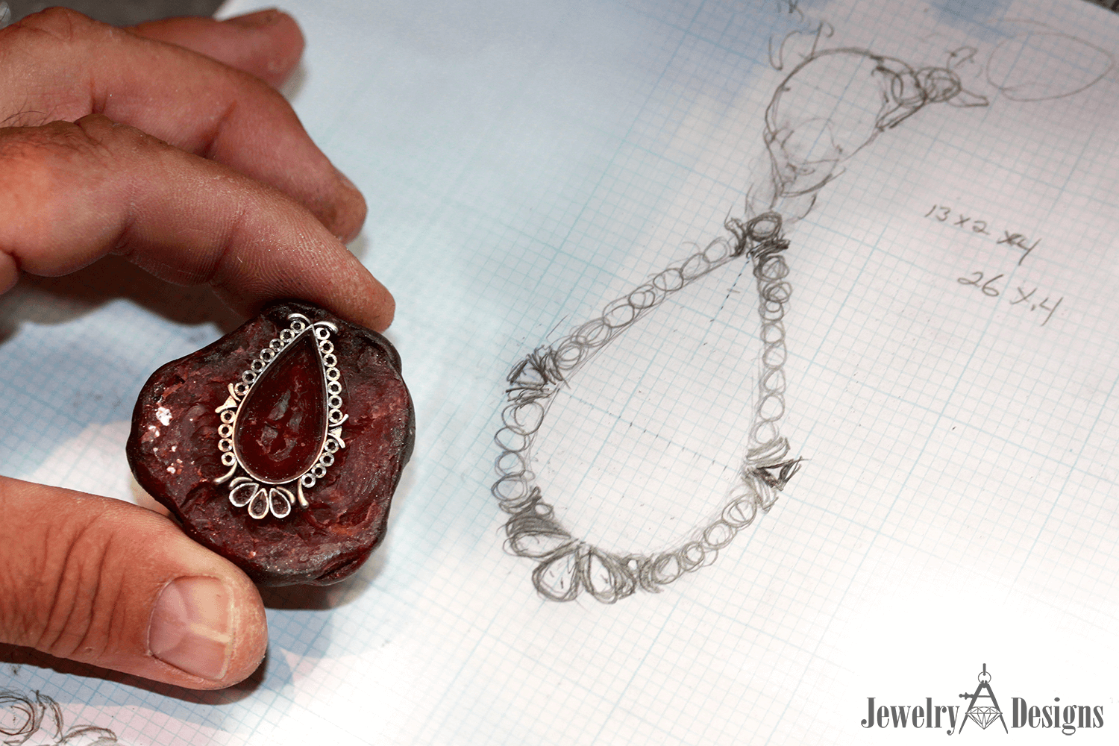
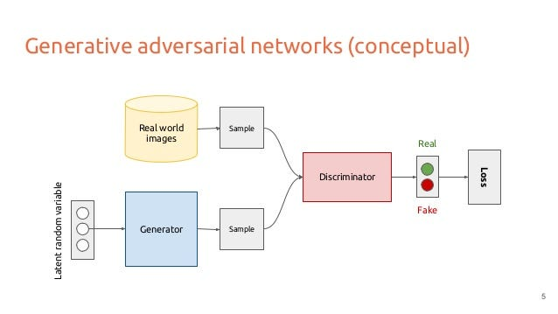
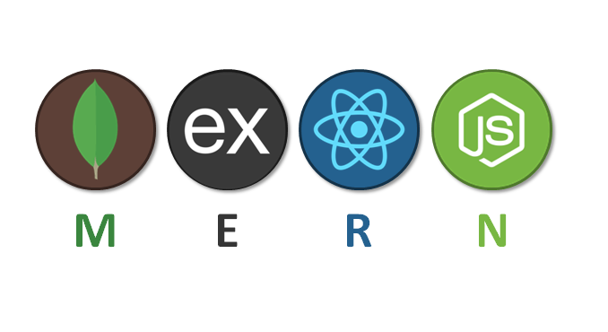
Scope of the Project:
Objective: project aims to convert customer sketches into realistic jewelry images using a combination of MERN stack technologies and Deep Learning.
MERN Stack: MongoDB, Express.js, React, Node.js for building the platform.
Deep Learning: Generative Adversarial Networks (GANs) for generating detailed jewelry images from sketches.
“This solution enables merchants to instantly visualize custom jewelry designs from simple sketches”

Slide 3
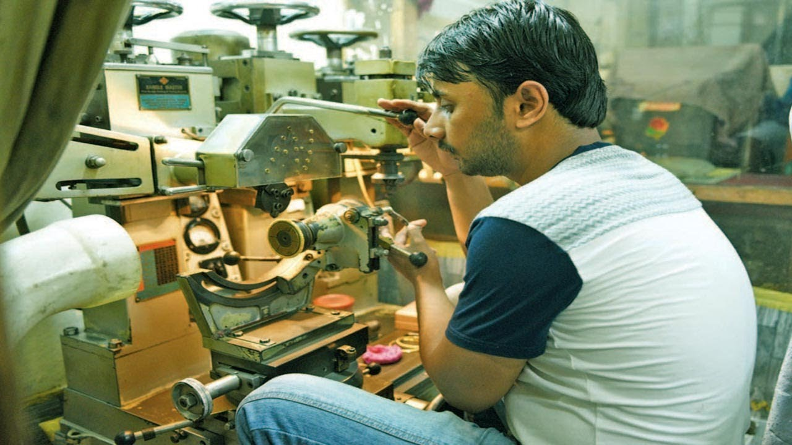
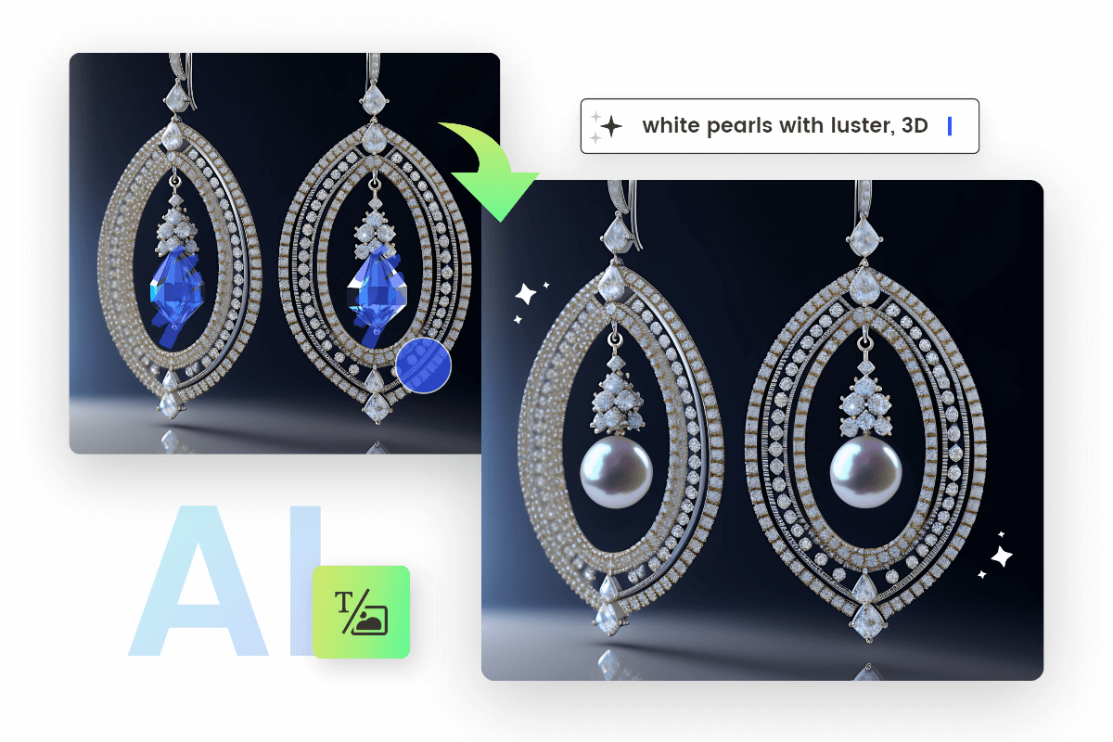
Business Case
Current Challenge: Difficulty in visualizing how sketches will translate into finished jewelry, leading to potential misunderstandings and dissatisfaction.
Traditional Process: Manual effort and time-consuming processes to create realistic previews.
Our Solution: Automates the visualization using GANs, integrated into a MERN stack platform, providing instant and high-quality previews, improving efficiency and customer satisfaction.

Slide 4
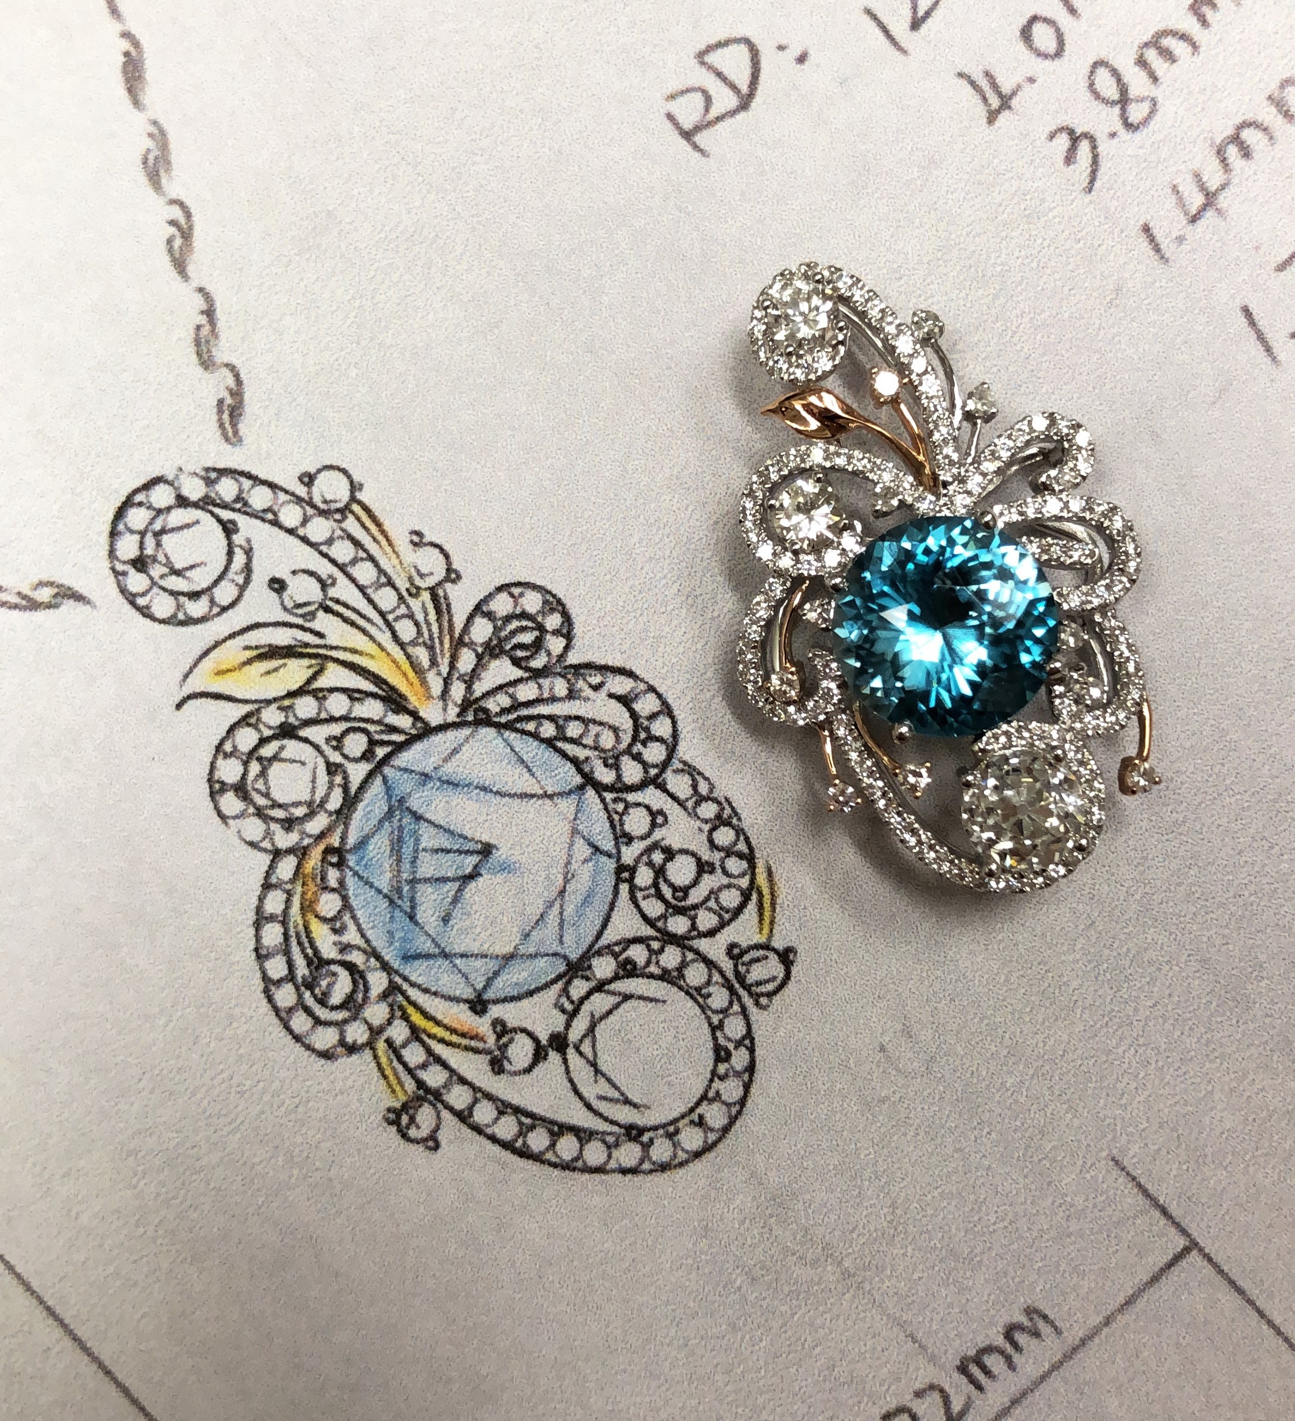
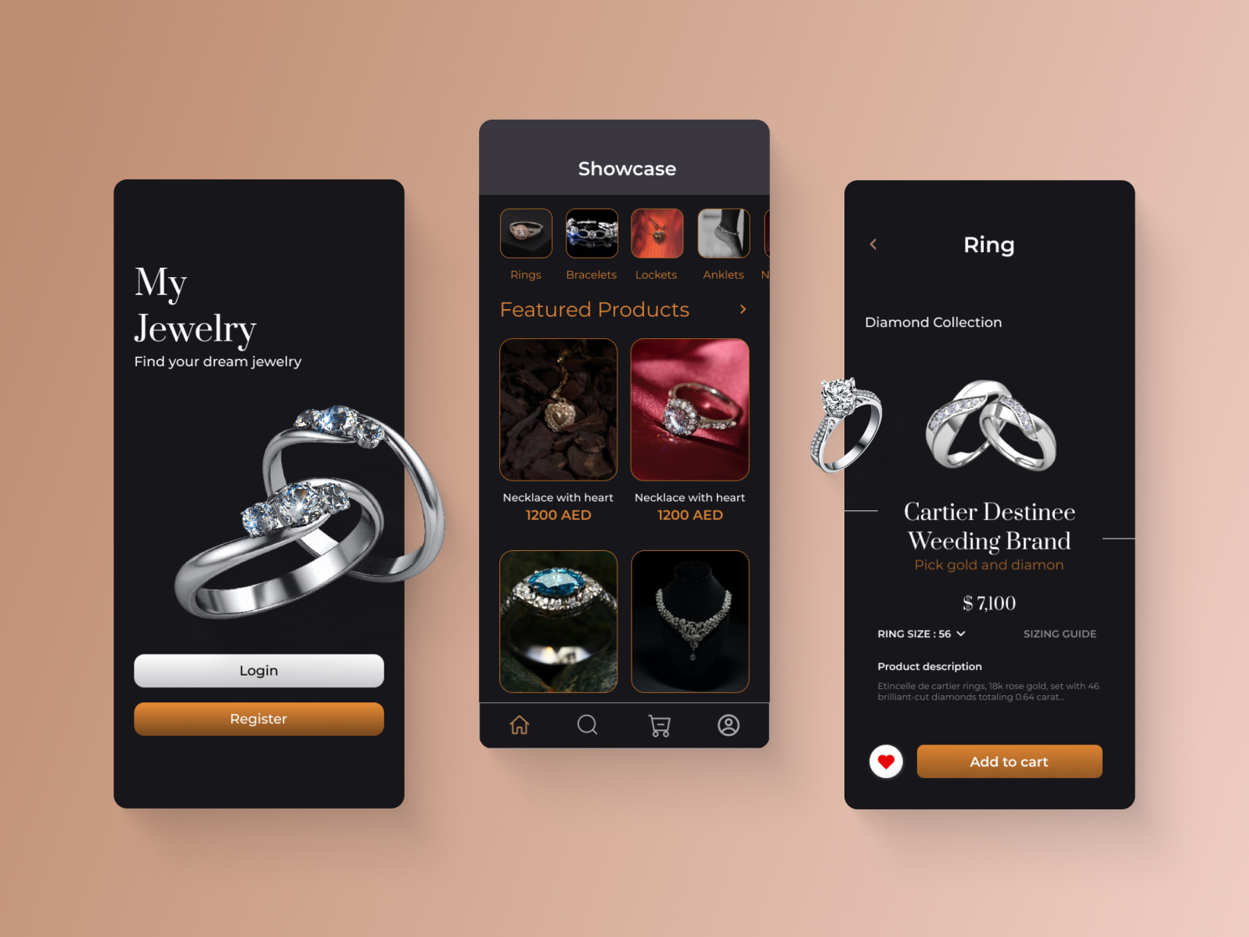
Typical Users & Benefits
Typical Users:
Jewelry Merchants: Need quick and accurate previews of custom jewelry designs to show customers.
Customers: Want to see realistic previews of their sketches before finalizing their purchase.
Designers: Require efficient tools for visualizing and refining custom jewelry designs.
Benefits:
For Merchants: Integrates GANs with the MERN stack to provide fast and realistic previews, enhancing customer interaction and decision-making.
For Customers: Offers clear and accurate visualizations of their custom designs, leading to more informed choices and improved satisfaction.
For Designers: Facilitates quick creation and refinement of detailed design previews, streamlining the design process.

Slide 5
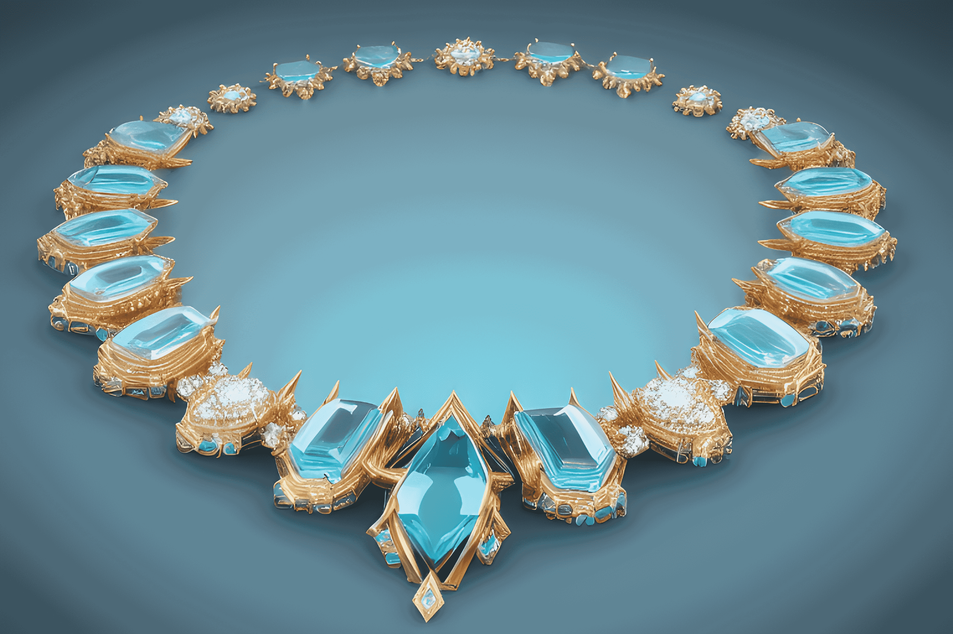
Conclusion:
In summary, our project combines the MERN stack with Deep Learning to revolutionize the way jewelry designs are visualized.
By converting customer sketches into realistic images using GANs, we provide a powerful tool for merchants, designers, and customers.
This approach enhances efficiency, improves customer satisfaction, and facilitates creative design processes.

